Slide 1


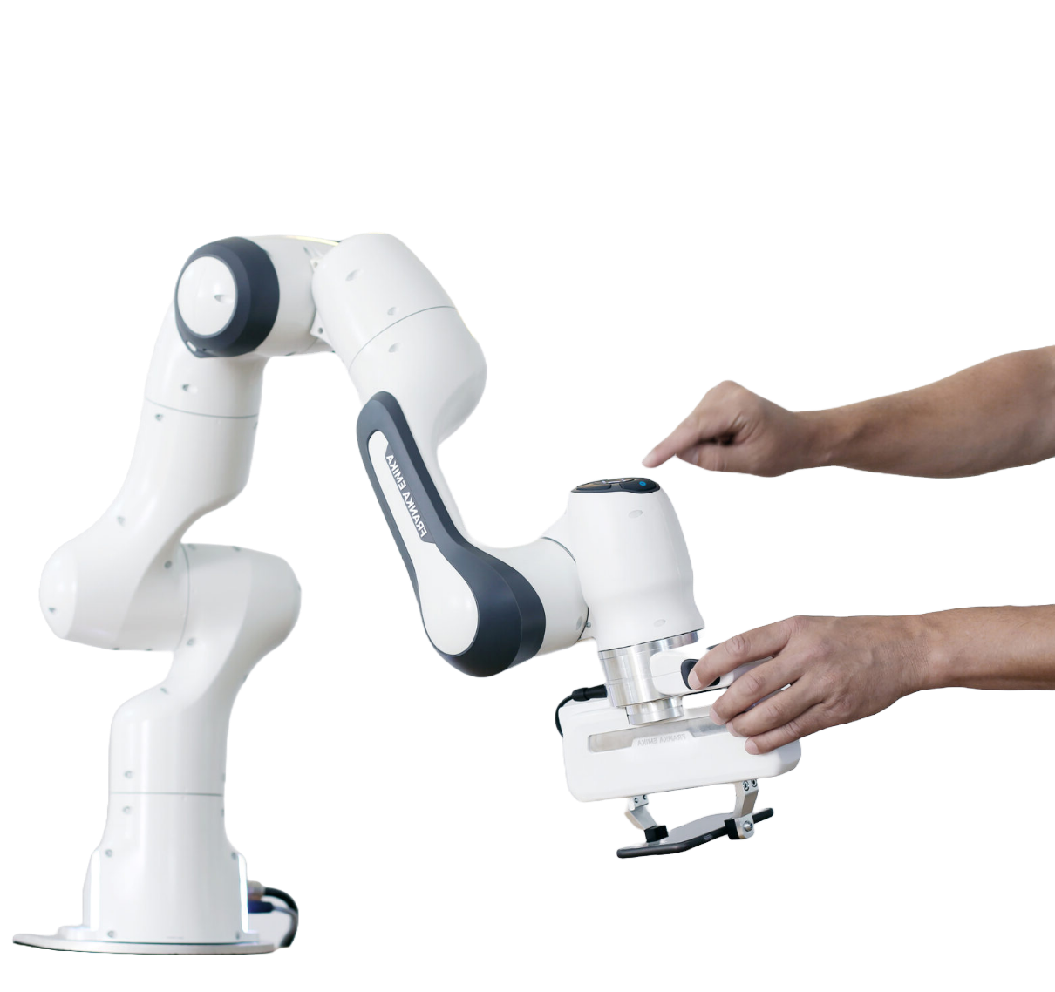

Adaptation of AlphaPose for obstacle avoidance in collaborative robotics
Author: Gašper Šavle
Ljubljana, december 2024

Slide 2
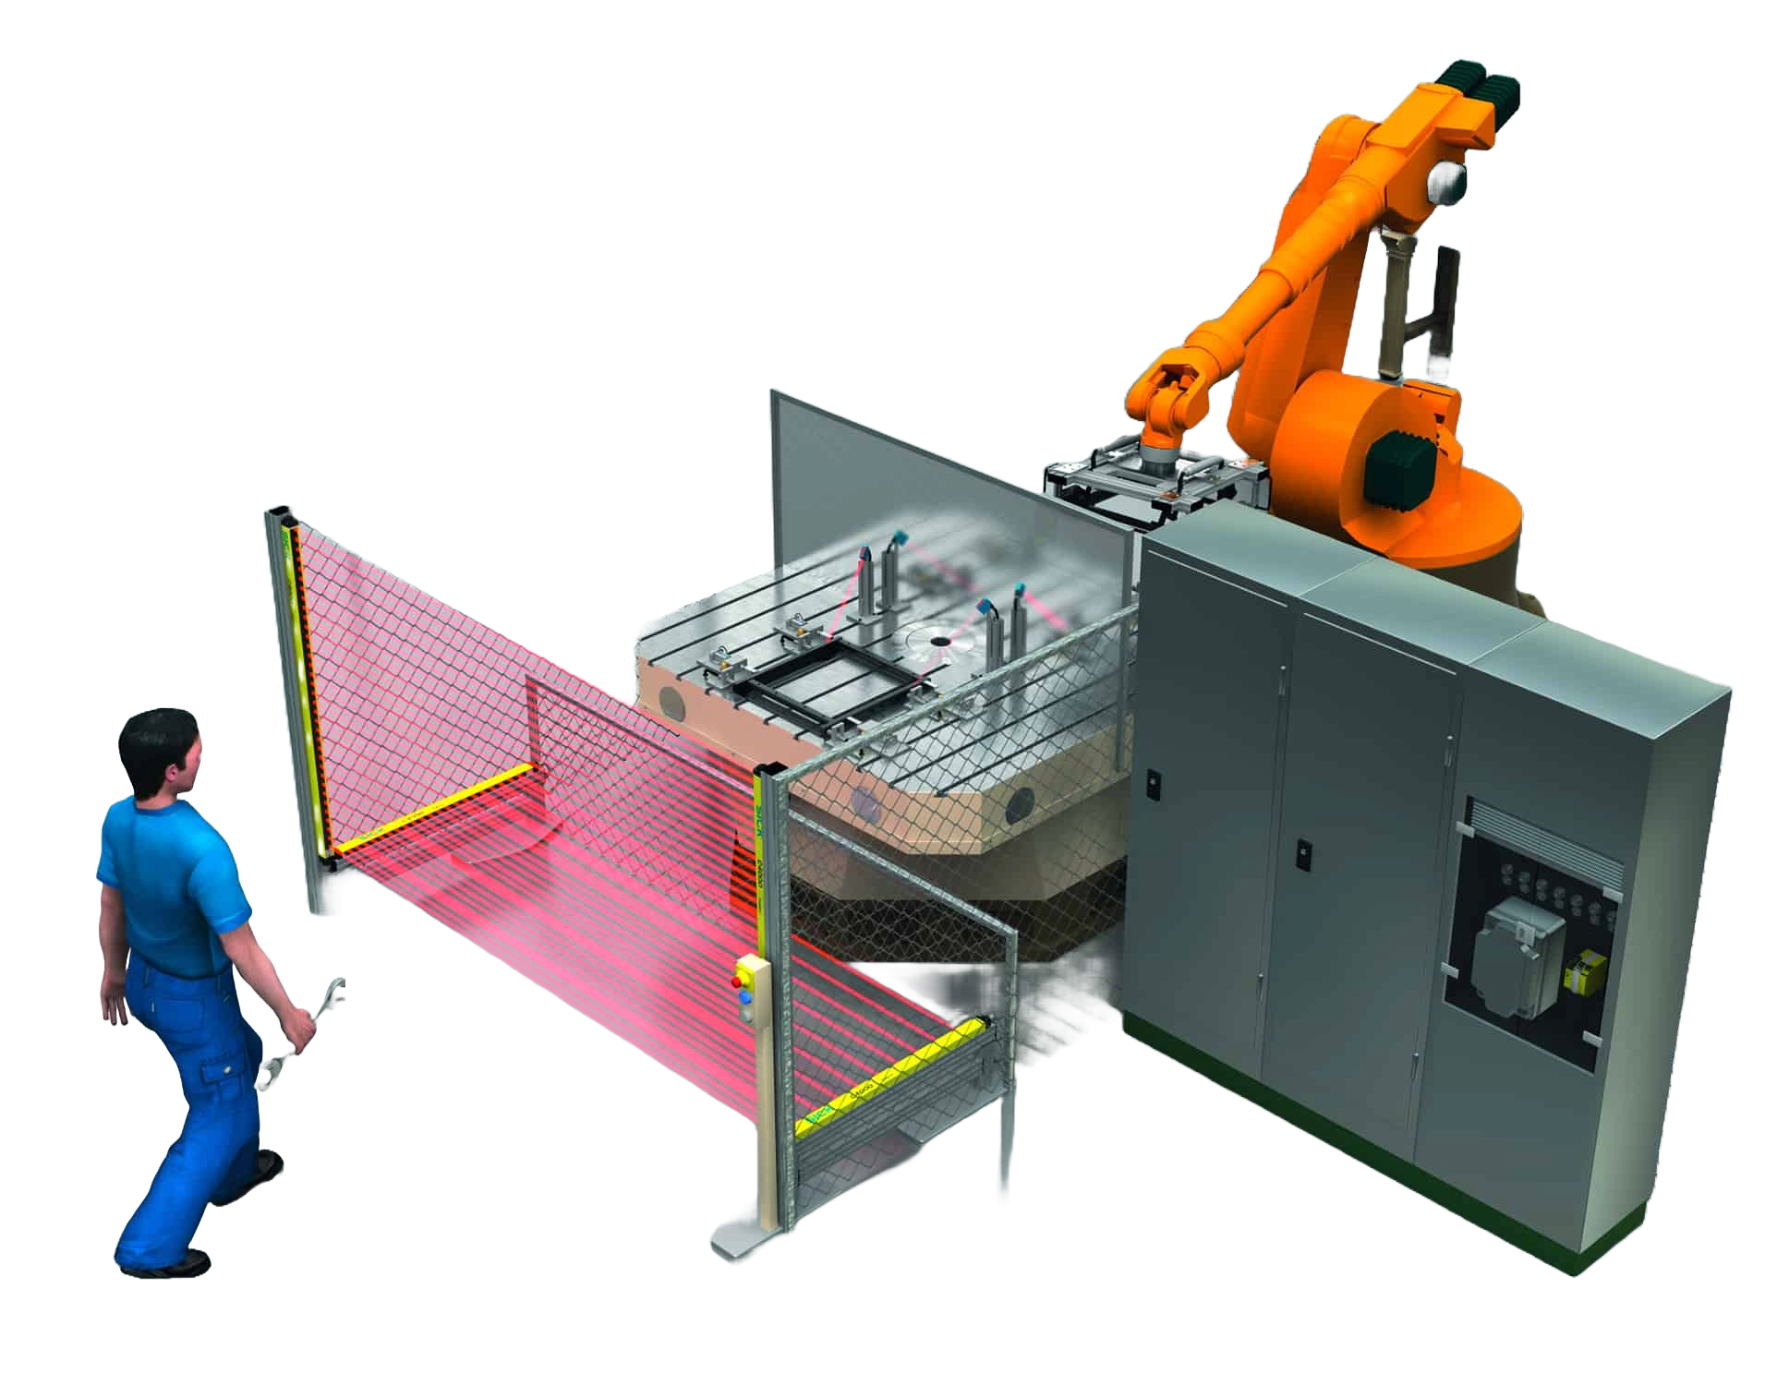
Introduction
Briefing
Collaborative robotics
Implementation

Slide 3
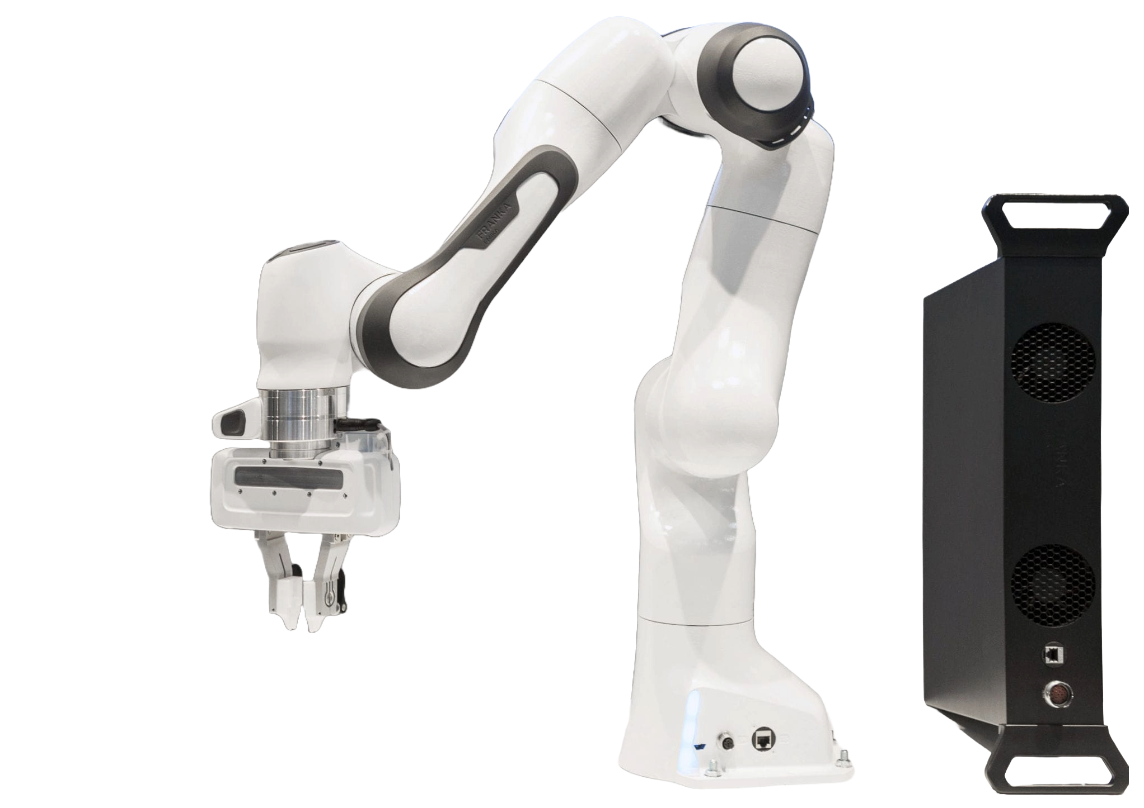
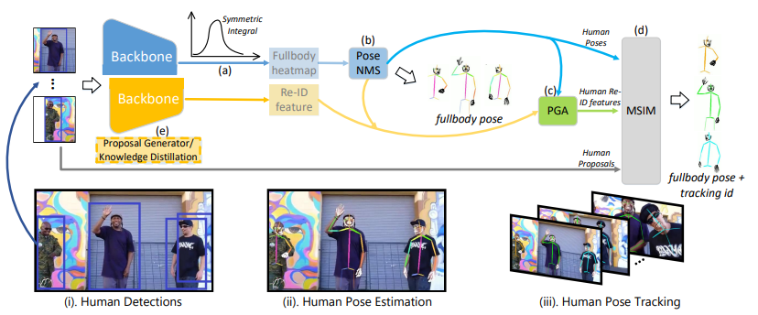

Key components
Franka Emika Panda
Redundant, collaborative robot
AlphaPose
Real-time pose estimation
ROS
Set of libraries
Focus on modularity

Slide 4
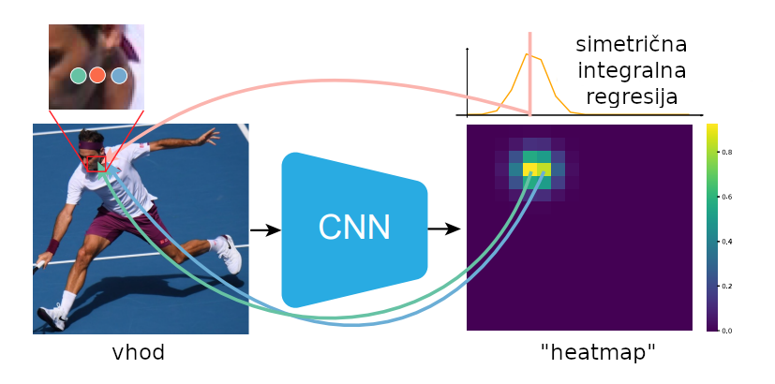
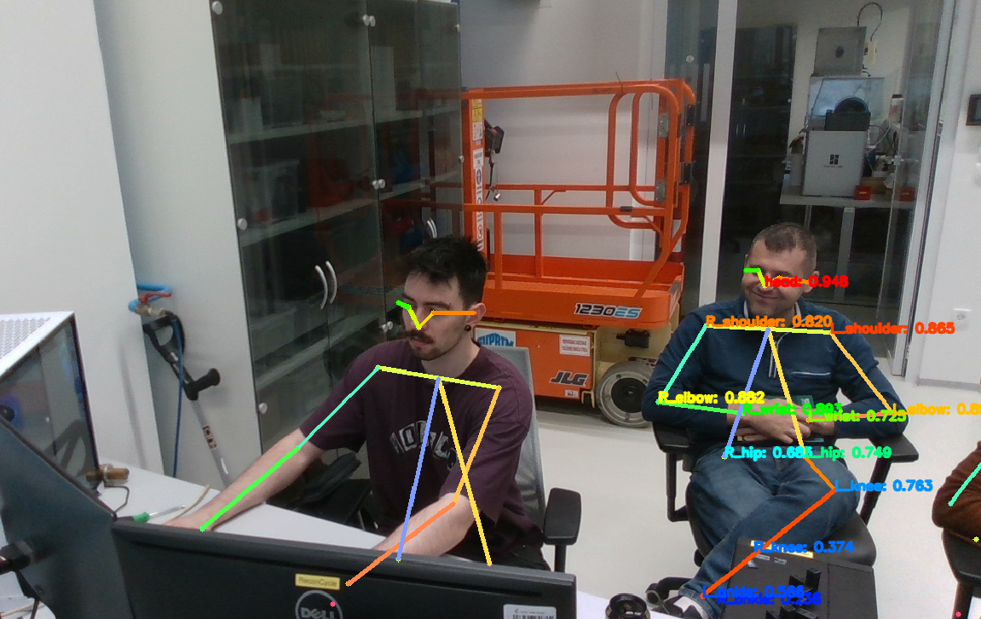
AlphaPose
Symmetric Integral Keypoint Regression
Fixes non-derivability of “heatmap” output
Fixes quantization error of CNN output
Reduces computational load by acknowledging human body symmetricity
Parametric Pose Non-Maximum-Suppression - PP-NMS
Solves redundant pose detection while mitigating the need for increased confidence thresholds
Thus enables multi-person pose estimation

Slide 5
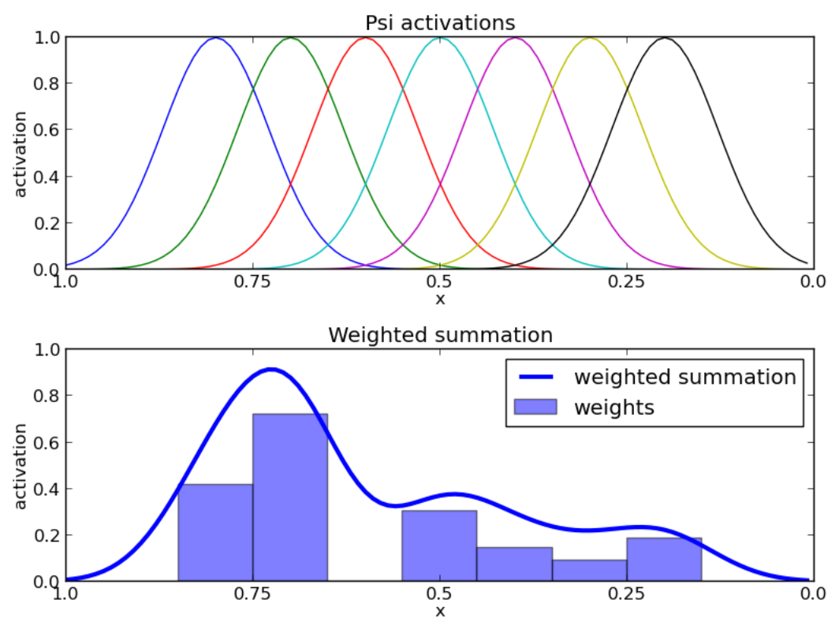
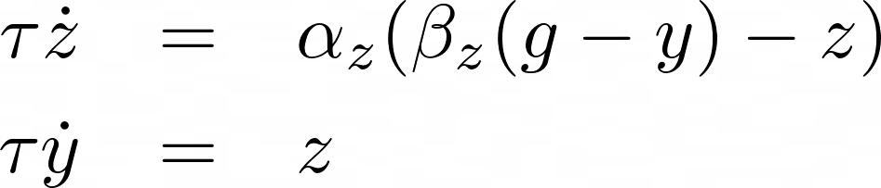
Dynamic motion primitives (DMP)
Reproduction of complex movements
Generalisation
Time scaling

Slide 6
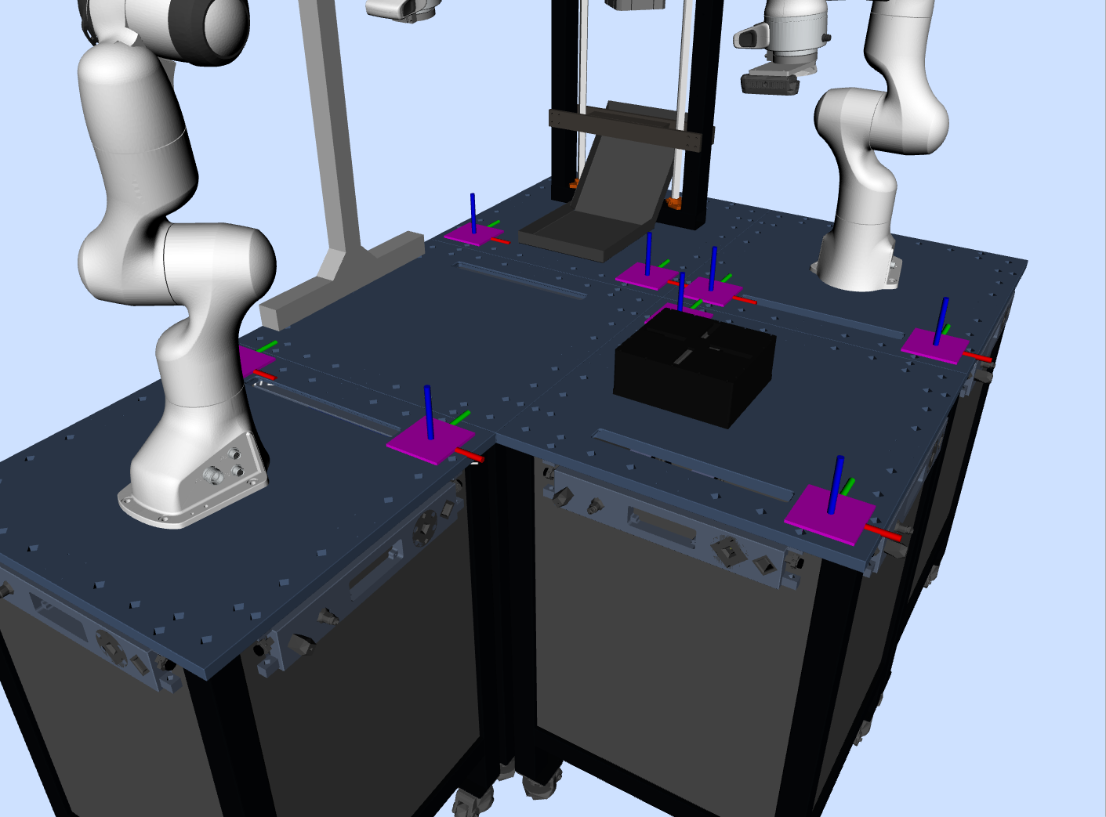
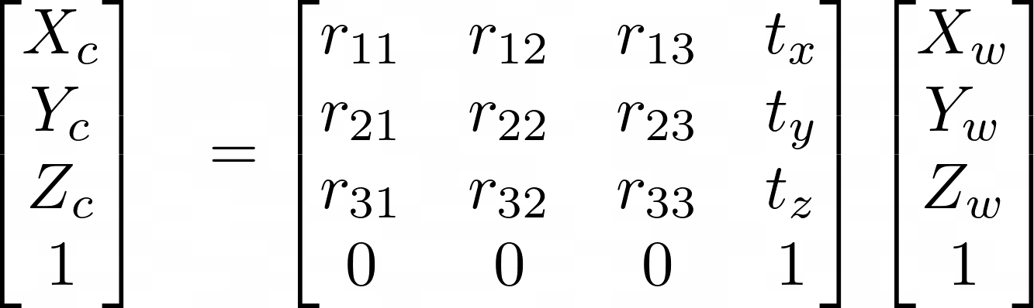
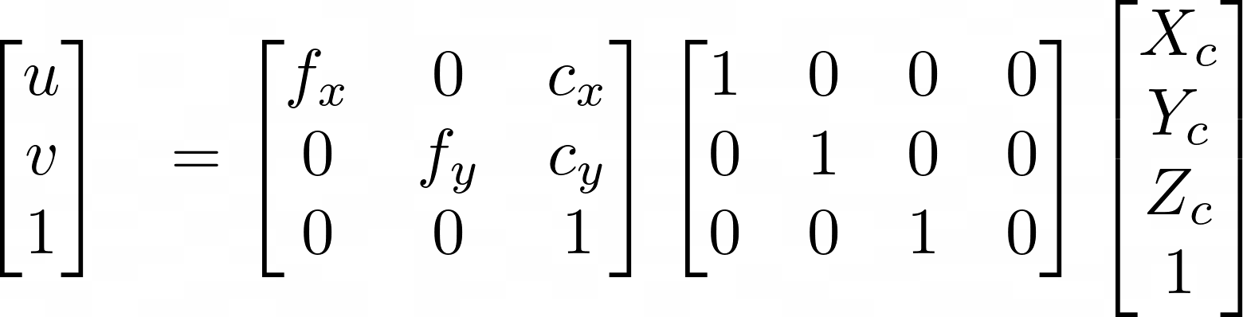
Calculating the Camera pose
Perspective N-Point
Pose correction
iterative comparison of detected marker poses and actual poses

Slide 7
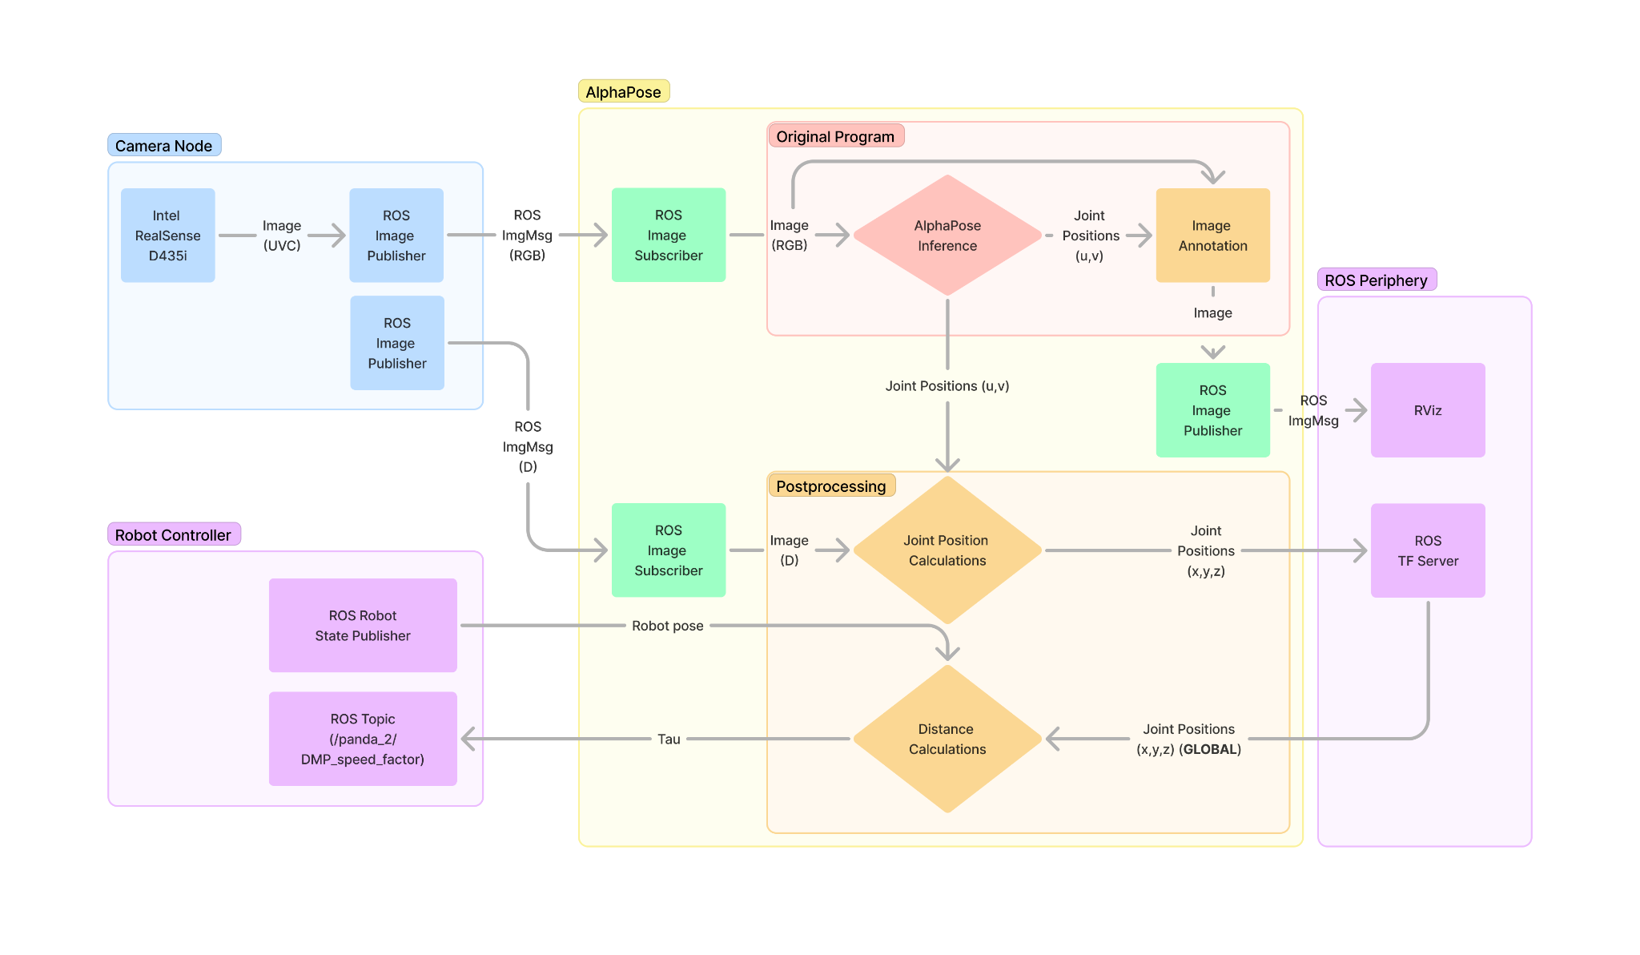
AlphaPose Adaptation

Slide 8
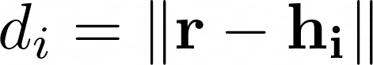
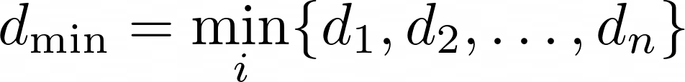
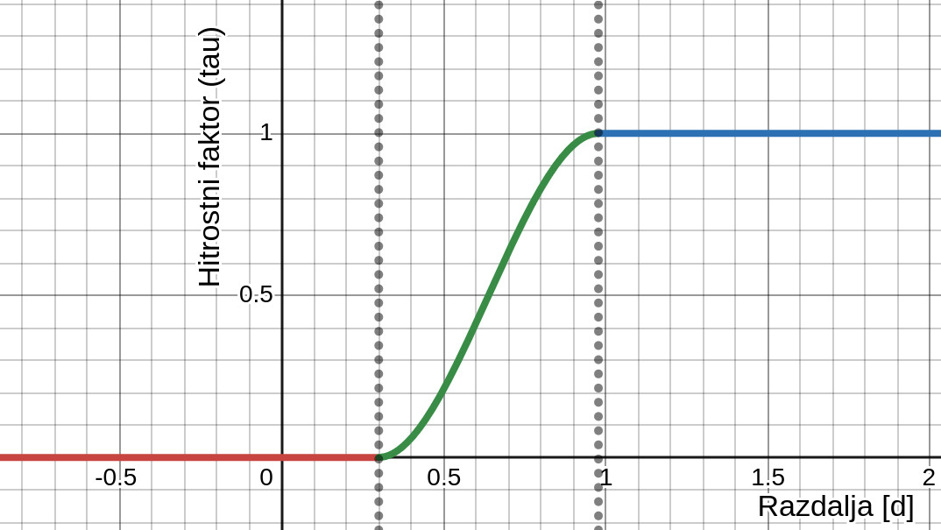
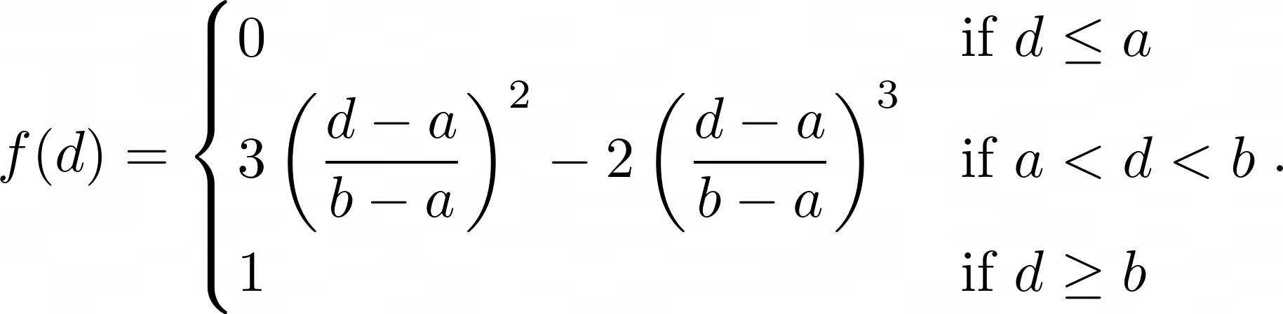
Distance and velocity factor calculation
Euclidean distance
Safety margin calculation (ISO 13855)

Slide 9
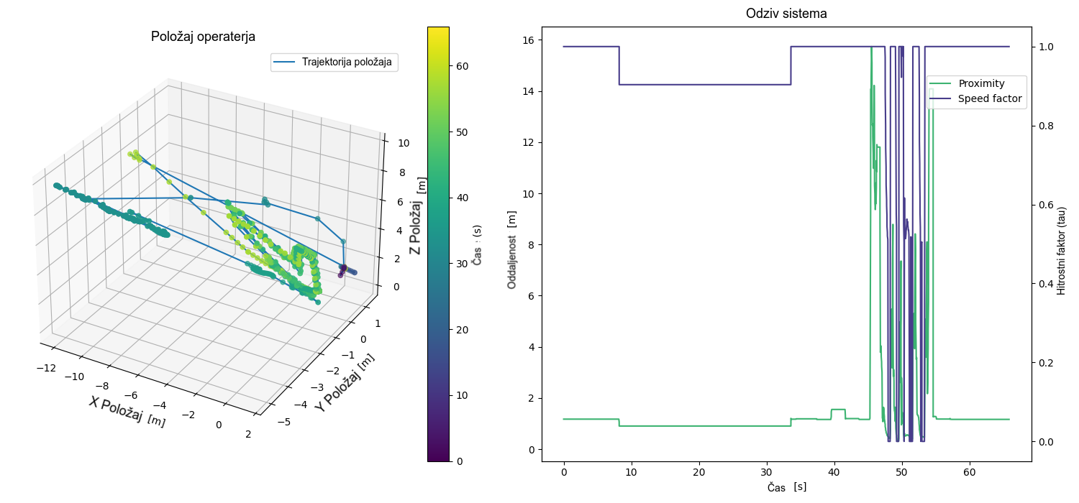
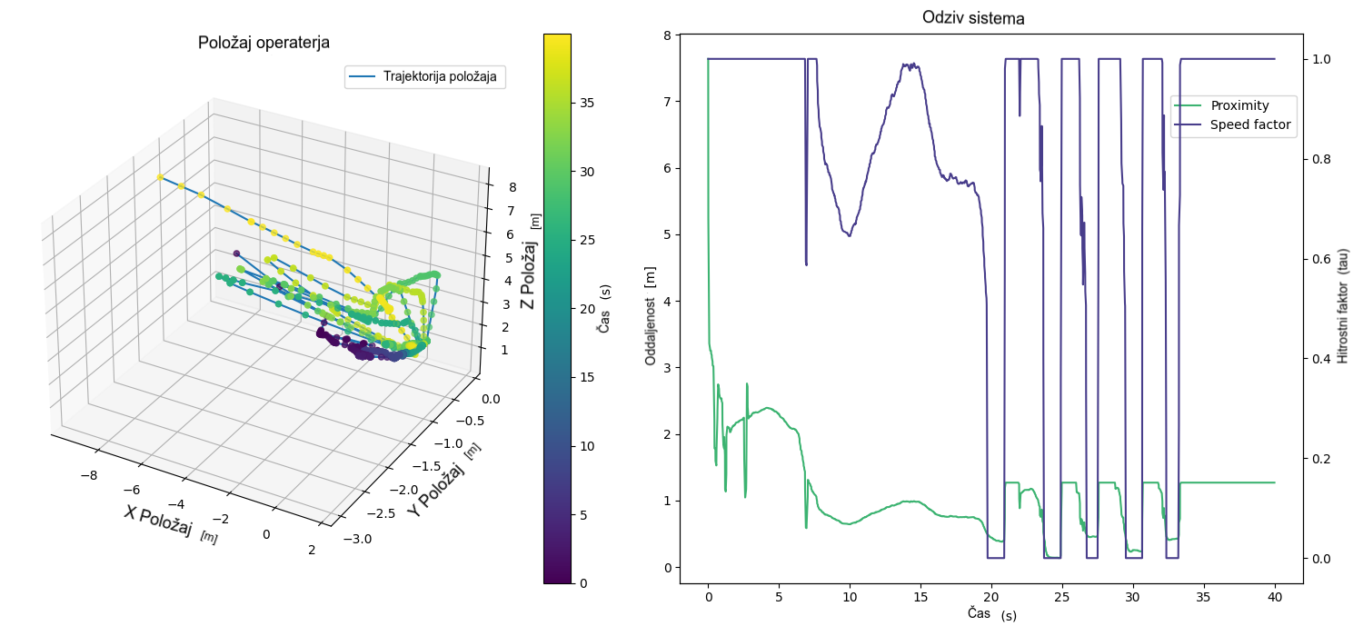
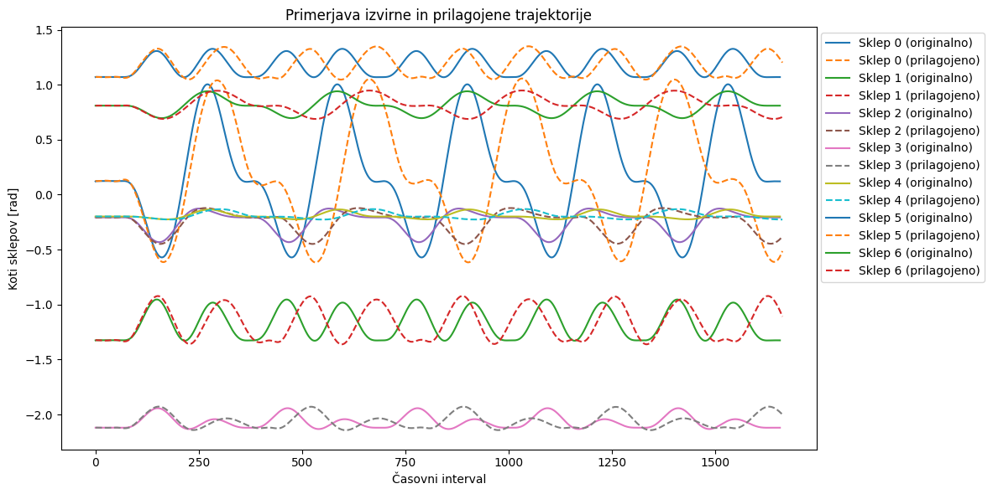
Evaluation and Results
Measurements:
operator pose,
robot joint poses,
distance,
velocity scaling factor
Changes in operator approach
Different camera poses
Different environmental conditions

Slide 10
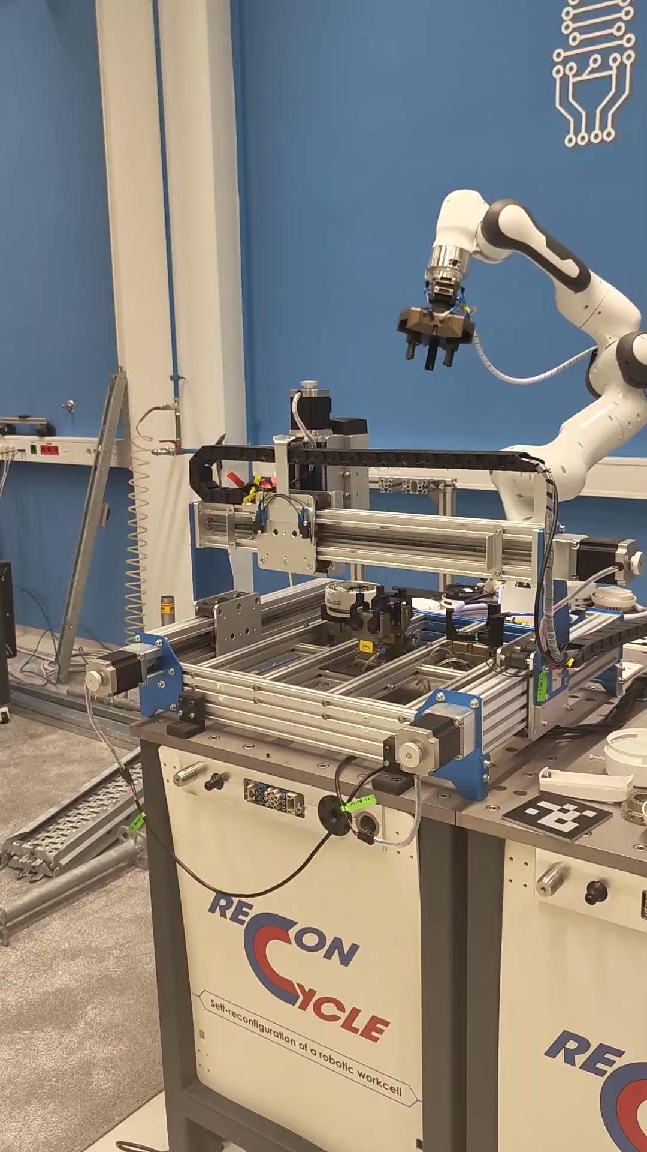
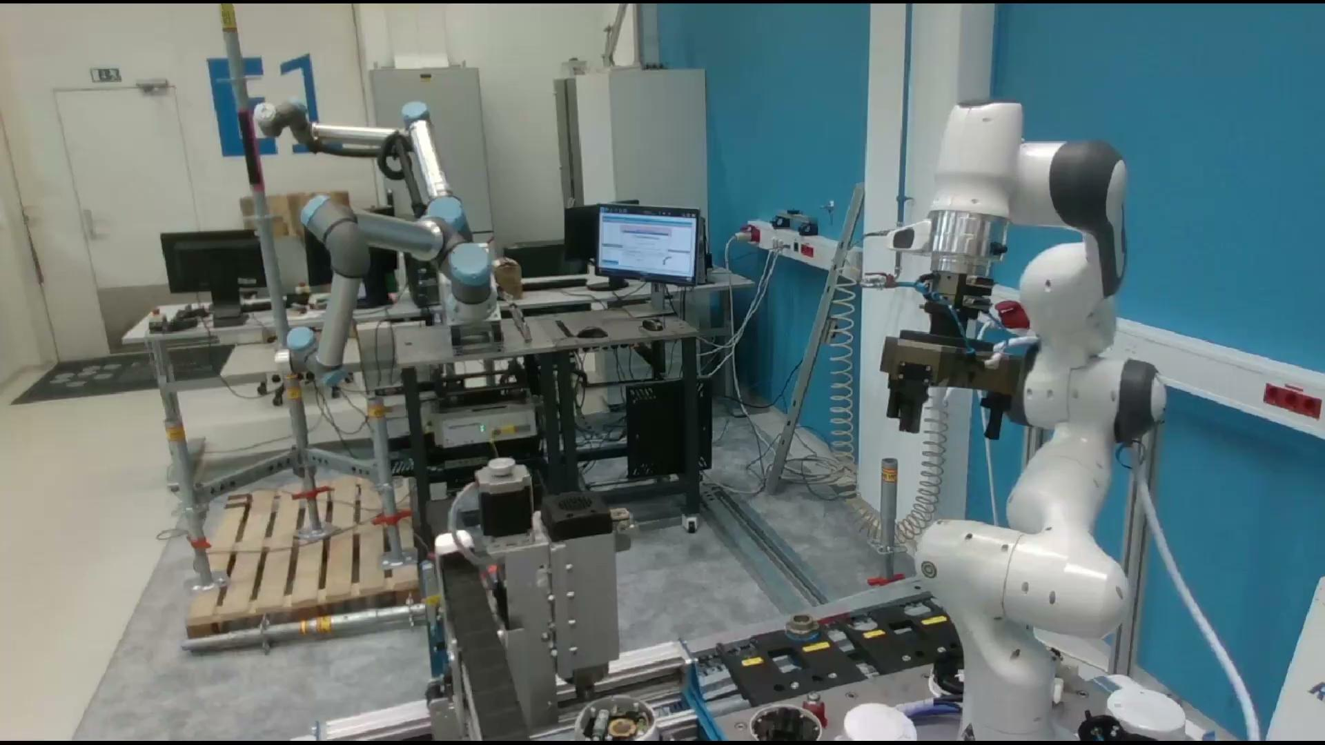
Demonstrations

